Slide 1
Appropriate Use Criteria Program
Required consultations for advanced imaging services

Slide 2
Purpose
“Increase the rate of appropriate advanced diagnostic imaging services provided to Medicare beneficiaries”

Slide 3
Regulatory Overview
Established via the Protecting Access to Medicare Act (PAMA) of 2014, Section 218(b)
Clinicians ordering advanced imaging services are required to consult a qualified Clinical Decision Support Mechanism (CDSM)
CDSM identifies whether the order adheres to appropriate use criteria (AUC) and generates a consultation code (G-code and modifiers)
Ordering provider must provide the CDSM consultation code to the furnishing provider/facility
Consultation code must be appended to Medicare Part B claims
Clinicians whose ordering patterns are considered outliers will be subject to prior authorization
Notes:
CMS has not yet created the methodology to determine the outlier physicians

Slide 4
Advanced Diagnostic Imaging Services
AUC must be consulted for the following types of exams:
Magnetic Resonance Imaging (MRI)
Computed Tomography (CT)
Positron Emission Tomography (PET)
Nuclear Medicine
Notes:
Law does not mandate ordering providers strictly adhere to the AUC, just consult AUC. There is no hard stop to the ordering process.

Slide 5
Clinical Decision Support Mechanism
Is an interactive, electronic tool approved by CMS
Uses AUC info developed, modified or endorsed by a CMS-approved provider-led entity (PLE)
Communicates AUC info to the user and assists them in making the most appropriate treatment decision for a patient’s specific clinical condition
No requirement that it be integrated into the EHR
Notes:
PLE is a national professional medical specialty society or other org that is comprised primarily or providers or practitioners who predominantly provide direct patient care

Slide 6
Clinical Decision Support Mechanisms
CareVue does not currently integrate with a CDSM
A list of all CDSM providers can be found at CMS.gov
https://www.cms.gov/Medicare/Quality-Initiatives-Patient-Assessment-Instruments/Appropriate-Use-Criteria-Program/CDSM
4 CDSM vendors currently offer free, non-integrated options
National Decision Support Company CareSelect™
Test Appropriate CDSM
AIM Specialty Health ProviderPortal®
LogicNets AUC Solution

Slide 7
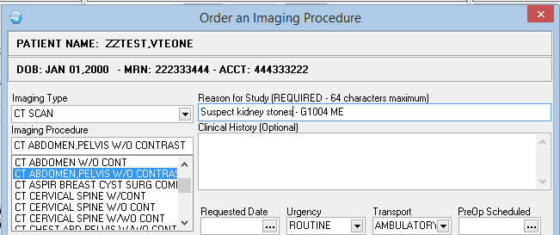
AUC G-Codes in CareVue
The responsibility to consult CDMS is with the ordering provider
If your providers order ED or outpatient radiology exams, they must consult a CDMS and record the resulting G-code and modifier
G-codes and modifiers must be attached to Medicare Part B claims
G-codes can be recorded in the “Reason for Study” field
Text added in “Reason for Study” will be visible in the Order Details. In this case the code G1004 and modifier ME have been added. This information should be included in the CMS bill.

Slide 8
Process Overview
Provider orders advanced imaging
CDSM tool invoked
AUC determined
G-code and modifier generated and attached to referral
Furnishing provider appends G-code/mod to claim
Ordering providers cannot shift AUC requirement to furnishing providers
Furnishing providers may refuse Medicare referrals without the G-code/mod documentation

Slide 9
Exemptions
Inpatient exams (outpatient exams done within the hospital are not exempt)
ED exams where the patient meets the EMTALA definition of having an Emergency Medical Condition
Limited exceptions may be made for rural providers with limited internet connectivity including:
Insufficient Internet access (e.g. rural areas);
EHR or CDSM vendor issues (e.g. technical problems, installation or upgrades temporarily impede access to CDSMs, vendors cease operations or CMS de-qualifies a CDSM; or
Extreme and uncontrollable circumstances (e.g. man-made or natural disasters, area infrastructure issues)

Slide 10
Timeline
2014 PAMA Finalized
2018 Voluntary Participation
2021 Penalties Applied
2020 Education and Operations Testing Period
Notes:
During the Education and Operations Testing Period, claims will not be denied for failing to include the AUC consultation info, but beginning in 2021, claims without this information appended will not be paid.

Slide 11
Additional Resources
https://www.cms.gov/Outreach-and-Education/Medicare-Learning-Network-MLN/MLNMattersArticles/downloads/MM11268.pdf

Slide 12
Questions?

